Slide 1
DESIGN OF A MATLAB-BASED VIRTUAL TRANSMITTER FOR Autonomous DRONE DEVELOPMENT
SUMMER RESEARCH PROJECT : CODE REVIEW
-SHUBHAM JENA
Research Intern under Dr. Derek A. Paley,
Willis H. Young Jr. Professor of Aerospace Engineering Education
Director, Collective Dynamics and Control Laboratory
Department of Aerospace Engineering
University of Maryland, College Park

Slide 2
MATLAB CODE OVERVIEW
Consists of 7 Matlab function files, 1 Matlab script file, 1 Matlab figure file & 2 text files
virtual_transmitter.fig
virtual_transmitter.m
param.m
kpcb.m
wbdcb.m
wbucb.m
wbmcb.m
send_stick_cmd.m
trim.txt
gains.txt
controller_fcn.m

Slide 3
MATLAB CODE OVERVIEW
virtual_transmitter.fig
virtual_transmitter.m
param.m
kpcb.m
wbdcb.m
wbucb.m
wbmcb.m
trim.txt
gains.txt
send_stick_cmd.m
controller_fcn.m
Notes:
Creates GUI figure window
Contains call-back function definitions for GUI objects in GUI figure window
Contains parameters (viz. ROS master IP, seial port etc.) needed for running virtual_transmitter.m

Slide 4
MATLAB CODE OVERVIEW
virtual_transmitter.fig
virtual_transmitter.m
param.m
kpcb.m
wbdcb.m
wbucb.m
wbmcb.m
trim.txt
gains.txt
send_stick_cmd.m
controller_fcn.m
Notes:
Call-back functions for keyboard and mouse control of GUI

Slide 5
MATLAB CODE OVERVIEW
virtual_transmitter.fig
virtual_transmitter.m
param.m
kpcb.m
wbdcb.m
wbucb.m
wbmcb.m
trim.txt
gains.txt
send_stick_cmd.m
controller_fcn.m
Notes:
Converts throttle, roll, pitch and yaw commands to PWM signals and send to transmitter via arduino

Slide 6
MATLAB CODE OVERVIEW
virtual_transmitter.fig
virtual_transmitter.m
param.m
kpcb.m
wbdcb.m
wbucb.m
wbmcb.m
trim.txt
gains.txt
send_stick_cmd.m
controller_fcn.m
Notes:
Contains low-level controller definitions (yaw control & altitude control)

Slide 7
MATLAB CODE OVERVIEW
virtual_transmitter.fig
virtual_transmitter.m
param.m
kpcb.m
wbdcb.m
wbucb.m
wbmcb.m
trim.txt
gains.txt
send_stick_cmd.m
controller_fcn.m
Notes:
Text files storing trim values and controller gains

Slide 8
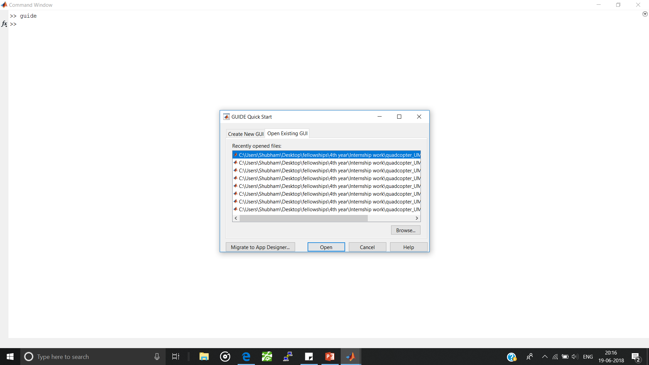
CODE BREAKDOWN:virtual_transmitter.fig

Slide 9
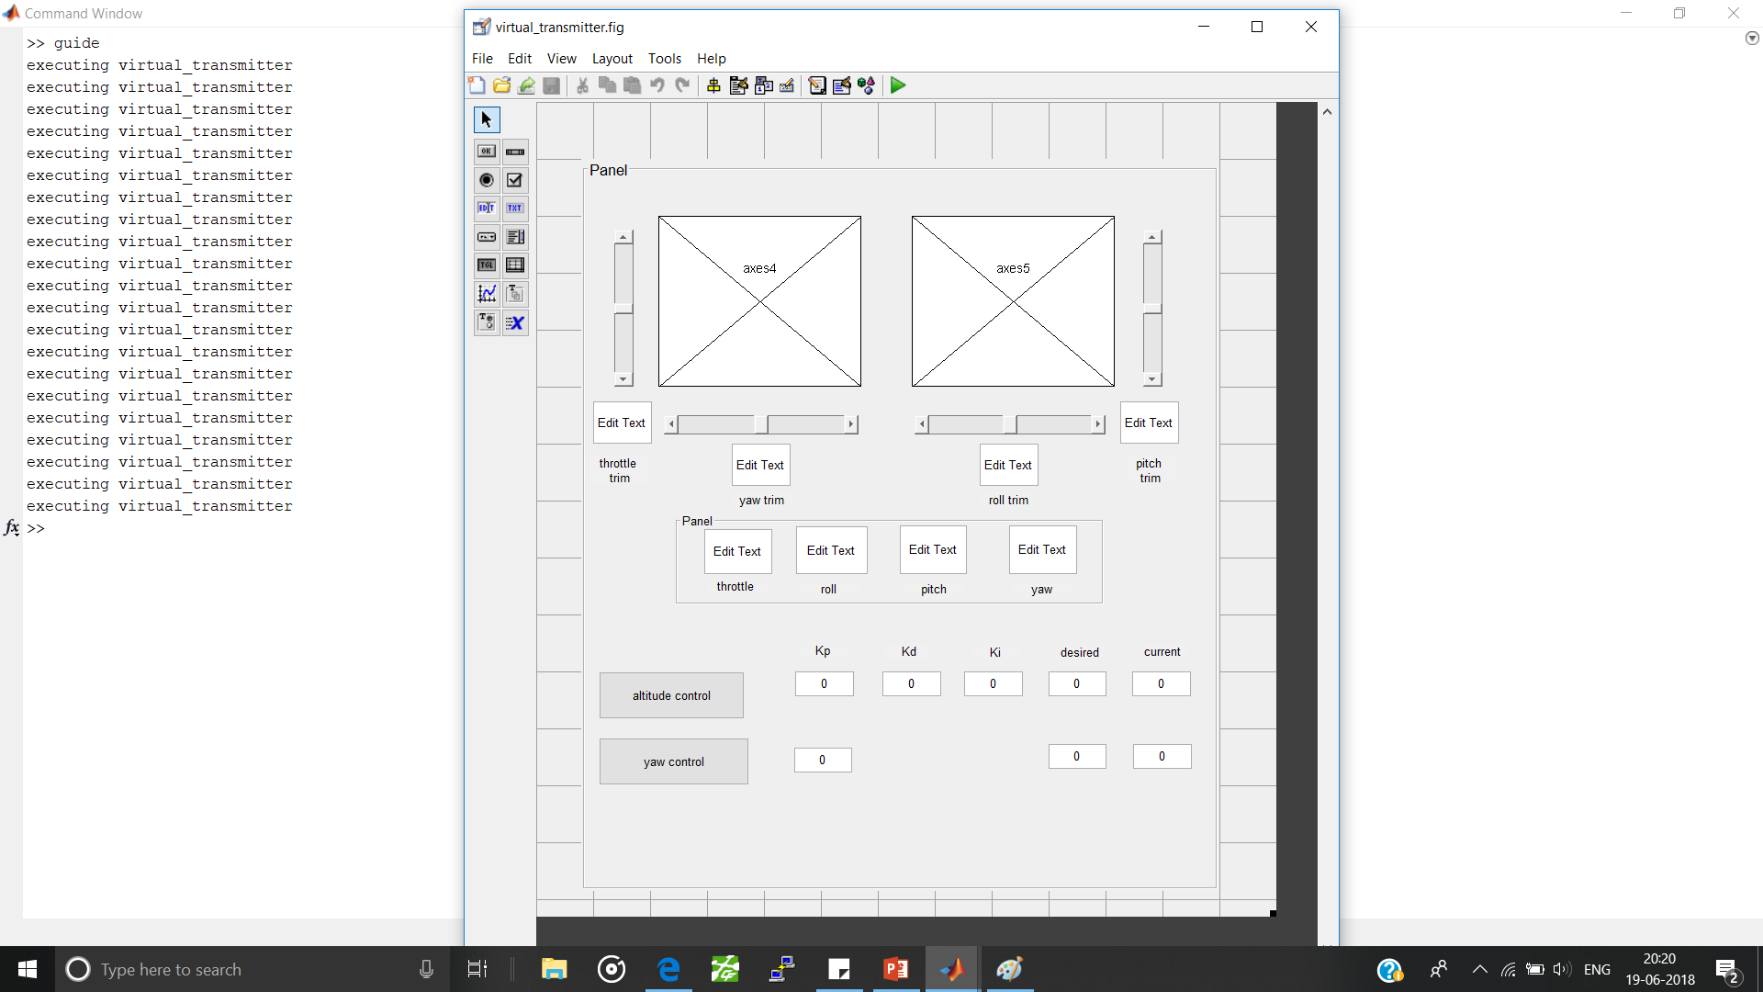
CODE BREAKDOWN:virtual_transmitter.fig

Slide 10
CODE BREAKDOWN:virtual_transmitter.fig

Slide 11
CODE BREAKDOWN:virtual_transmitter.fig
CreateFcn
CloseRequestFcn
WindowButtonDownFcn
WindowButtonUpFcn
KeyPressFcn

Slide 12
CODE BREAKDOWN:virtual_transmitter.fig
CreateFcn
CallbackFcn

Slide 13
CODE BREAKDOWN:virtual_transmitter.m
Auto-generated script file containing a collection of function definitions
virtual_transmitter.m
virtual_transmitter()
virtual_transmitter_OpeningFcn()
Call-back & CreateFcn function definations for GUI objects
virtual_transmitter_OutputFcn()
figure1_CloseRequestFcn()

Slide 14
CODE BREAKDOWN:virtual_transmitter.m
Auto-generated script file containing a collection of function definitions
virtual_transmitter.m
varargin
virtual_transmitter()
virtual_transmitter()
virtual_transmitter_OpeningFcn()
Call-back & CreateFcn function definations for GUI objects
virtual_transmitter_OutputFcn()
figure1_CloseRequestFcn()
Notes:
Initialises GUI
Runs each time call-back function for a GUI object is executed
No modification required
Varargin: command line arguments to virtual transmitter

Slide 15
CODE BREAKDOWN:virtual_transmitter.m
Auto-generated script file containing a collection of function definitions
hObject, eventData,
handles, varargin
virtual_transmitter.m
param.m
kpcb()
virtual_transmitter()
wbdcb()
virtual_transmitter_OpeningFcn()
Call-back & CreateFcn function definations for GUI objects
virtual_transmitter_OpeningFcn()
wbmcb()
virtual_transmitter_OutputFcn()
wbucb()
figure1_CloseRequestFcn()
controller_fcn()
gains.txt
trims.txt
send_stick_cmd()
Notes:
Executes exactly once, during GUI initialisation
closes open COM ports; Clears any persistent variables; Sets initial stick and trim positions;
Intialises ROS node ; Initialises Timer object- calls controller_fcn.m at rate specified by ‘time_period’ ; Creates imu and lidar data subscribers
KeyPressFcn - kpcb.m ; WindowButtonDownFcn - wbdcb.m ;windowButtonUpFcn -wbucb.m
hObject: handles to gui figure; eventdata: reserved to be defined in a future version of Matlab; handles: structure with handles and user data

Slide 16
CODE BREAKDOWN:param.m
com_port = 'COM3';
baud_rate = 57600;
stick_lim = [100; 100; 100; 100];
trim_lim = [29; 29; 29; 29];
ros_master_ip = '10.1.10.178';
time_period = 0.01;
Notes:
No inputs no outputs

Slide 17
CODE BREAKDOWN: kpcb()
Determine key pressed
Get new stick positions
Call send_stick_cmd() with the new stick positions
src, evnt, handles
send_stick_cmd()
Notes:
Maps keyboard inputs to gui

Slide 18
CODE BREAKDOWN: wbdcb.m, wbmcb.m, wbucb.m
wbdcb()
Determine if mouse was clicked on the right side control stick
Set 'WindowButtonMotionFcn’ to wbmcb()
wbmcb()
Get current mouse pointer location
Calculate u_stick_cmd
Call send_stick_cmd()
wbucb()
Set 'WindowButtonMotionFcn’ to NULL
src, evnt, handles, ax
src, evnt, handles
src, evnt, handles
Notes:
Map mouse inputs to gui

Slide 19
CODE BREAKDOWN: send_stick_cmd.m
Receive current stick position and trim slider values from calling function
If received values are not infinity, update persistent variables u_stick and trim1
Draw control sticks at new positions on the GUI
Calculate u_stick_net; normalise to [-1 1]
Scale u_stick_net to [1000 9000] and print to COM port.
Update stick position information in the GUI display
u_stick_cmd, trim, handles

Slide 20
CODE BREAKDOWN: controller_fcn.m
Display current IMU and lidar data in GUI display
If yaw control toggle button is depressed, execute yaw control
If altitude control toggle button is depressed, execute altitude control
Call send_stick_cmd() with the calculated positions of throttle and yaw sticks
obj,evnt,handles
send_stick_cmd()

Slide 21
CODE BREAKDOWN:virtual_transmitter.m
Auto-generated script file containing a collection of function definitions
virtual_transmitter.m
hObject, eventdata,handles
virtual_transmitter()
virtual_transmitter_OpeningFcn()
Call-back & CreateFcn function definations for GUI objects
virtual_transmitter_OutputFcn()
figure1_CloseRequestFcn()
Notes:
Executes once, during GUI initialisation
No modifications made

Slide 22
CODE BREAKDOWN:virtual_transmitter.m
Auto-generated script file containing a collection of function definitions
virtual_transmitter.m
hObject,eventdata, handles
virtual_transmitter()
virtual_transmitter_OpeningFcn()
Call-back & CreateFcn function definations for GUI objects
virtual_transmitter_OutputFcn()
figure1_CloseRequestFcn()

Slide 23
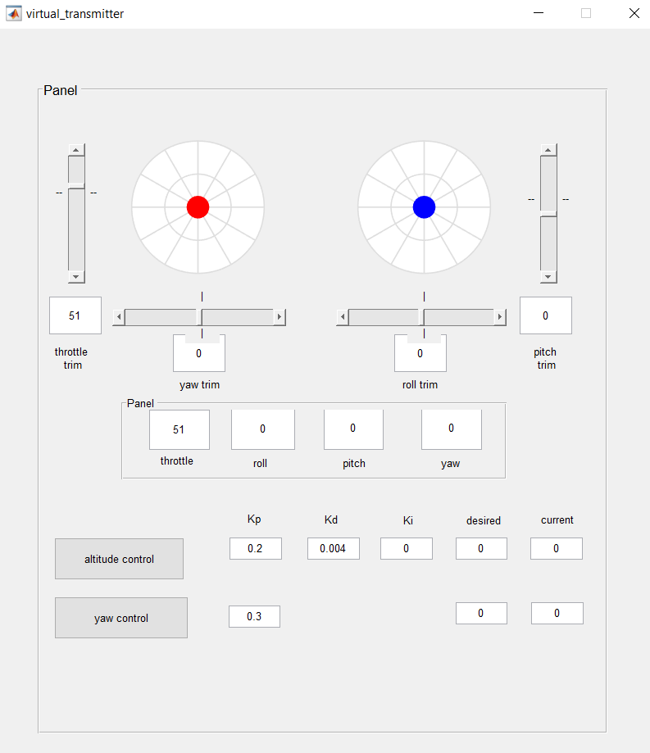
CODE BREAKDOWN:virtual_transmitter.m
Call-back & CreateFcn function definations for GUI objects
Uipanel1_CreateFcn()

Slide 24
CODE BREAKDOWN:virtual_transmitter.m
Call-back & CreateFcn function definations for GUI objects
Uipanel1_CreateFcn()
axes4_CreateFcn
axes5_CreateFcn

Slide 25
CODE BREAKDOWN:virtual_transmitter.m
Call-back & CreateFcn function definations for GUI objects
Uipanel1_CreateFcn()
slider2_Callback()
slider2_CreateFcn()
slider6_Callback()
slider6_CreateFcn()
slider5_Callback()
slider5_CreateFcn()
slider3_Callback()
slider3_CreateFcn()
axes4_CreateFcn()
axes5_CreateFcn()

Slide 26
CODE BREAKDOWN:virtual_transmitter.m
Call-back & CreateFcn function definations for GUI objects
thrust_trim_textbox_Callback()
thrust_trim_textbox_CreateFcn()

Slide 27
CODE BREAKDOWN:virtual_transmitter.m
Call-back & CreateFcn function definations for GUI objects
thrust_trim_textbox_Callback()
thrust_trim_textbox_CreateFcn()
thrustDisplay_Callback()
thrustDisplay_CreateFcn()

Slide 28
CODE BREAKDOWN:virtual_transmitter.m
Call-back & CreateFcn function definations for GUI objects
thrust_trim_textbox_Callback()
thrust_trim_textbox_CreateFcn()
thrustDisplay_Callback()
thrustDisplay_CreateFcn()
altitude_control_radio_Callback()
yaw_control_radio_Callback()

Slide 29
CODE BREAKDOWN:virtual_transmitter.m
Call-back & CreateFcn function definations for GUI objects
k_h_editTextBox_Callback()
k_h_editTextBox_CreateFcn()
k_h_d_editTextBox_Callback()
k_h_d_editTextBox_CreateFcn()
k_h_i_editTextBox_Callback()
k_h_i_editTextBox_CreateFcn()
h_des_editTextBox_Callback()
h_des_editTextBox_CreateFcn()
h_a_editTextBox_Callback()
h_a_editTextBox_CreateFcn()
Notes:
Similarly for yaw control

Slide 30
CODE BREAKDOWN:virtual_transmitter.m
Auto-generated script file containing a collection of function definitions
virtual_transmitter.m
hObject, eventdata,handles
virtual_transmitter()
virtual_transmitter_OpeningFcn()
Call-back & CreateFcn function definations for GUI objects
virtual_transmitter_OutputFcn()
figure1_CloseRequestFcn()
Notes:
Executes when GUI figure window is closed; Deletes timer object and any global variables
Shuts down ROS node
Saves trim values and gains to file

Slide 31
THANK YOU

Slide 32
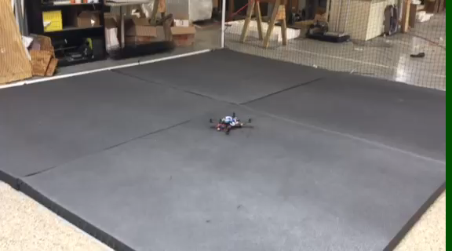
Altitude Controller Test

Slide 33
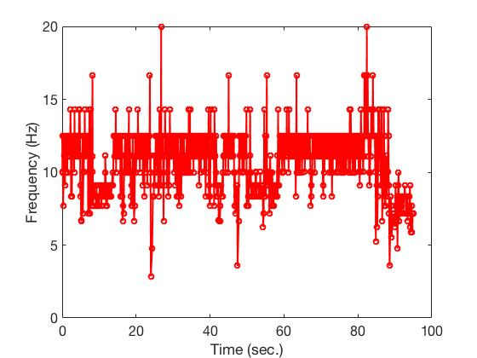
Altitude control plots

Slide 34
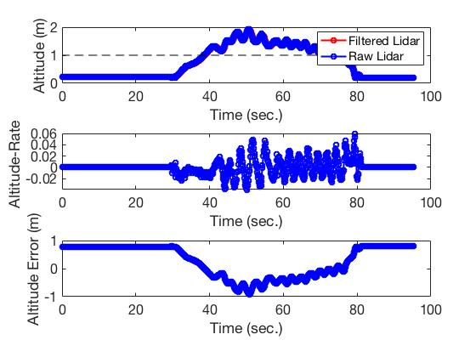
Altitude control plots

Slide 35
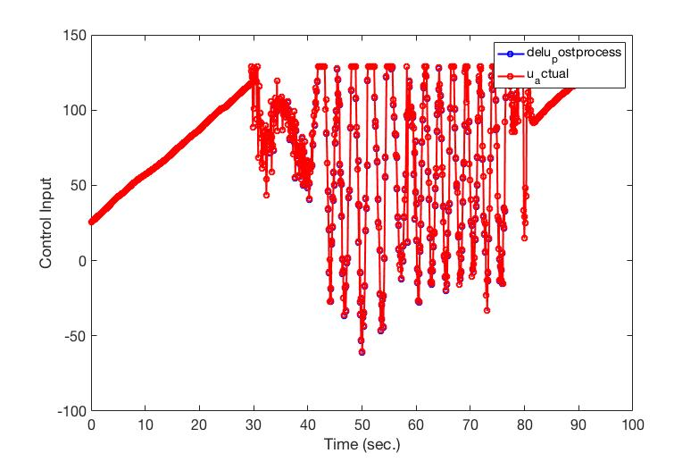
Altitude control plots

